Slide 1
Project Update: Comparison of Support Vector Regression Models of Transcription Factor E2F1 and E2F4’s Binding Specificity to DNA Sequences
Sunwoo Yim
Gordan Lab at Duke Centor for Genomic and Computational Biology

Slide 2
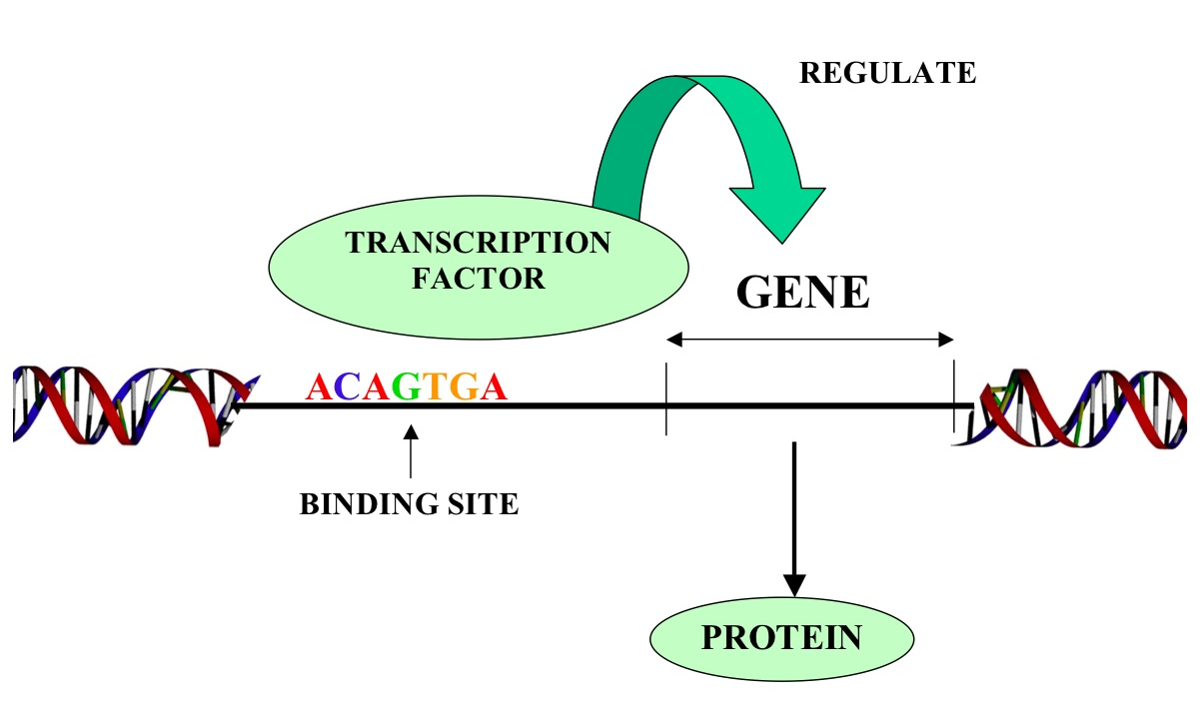
TF binding specificity to DNA sequences
E2F1
E2F4
Notes:
Gene contains information needed to build protein
E2F1 and E2F4
2600 TFs in human body

Slide 3
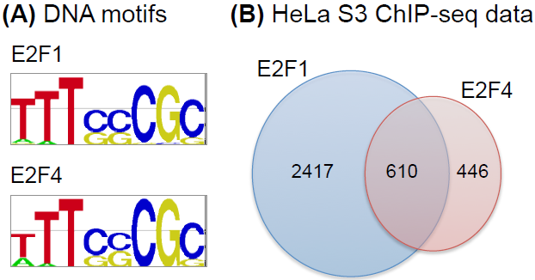
Reason for Research
Notes:
Reason for research
Interdependency- not all considered indep

Slide 4
Core: GCGC and GCGG
Mers?
1mer Feature
1-A 0
1-C 0
1-G 1
1-T 0
2-A 1
2-C 0
2-G 0
2-T 0
2mer Feature
1-AA 0
1-AC 0
1-AG 0
1-AT 0
1-CA 0
1-CC 0
1-CG 0
…
1-GA 1
2-AA 0
3mer Feature
1-AAA 0
1-AAC 0
1-AAG 0
…
1-GAA 0
1-GAC 0
1-GAG 0
1-GAT 1
…
2-AAA 0
Support Vector Regression
Data -> training and testing sets
Notes:
Cores GCGC and GCGG

Slide 5
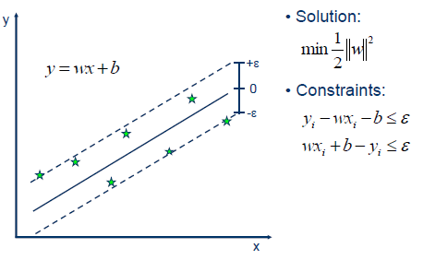
Parameters
C = cost
P = epsilon
Model from training set
Feature Weights
Notes:
click
Split data into training and testing data
5 fold cross validation
click

Slide 6
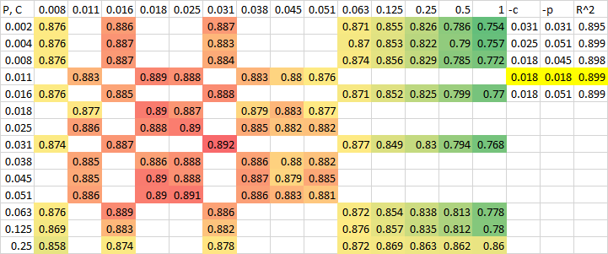
TF E2F1 Core GCGC Grid Search

Slide 7
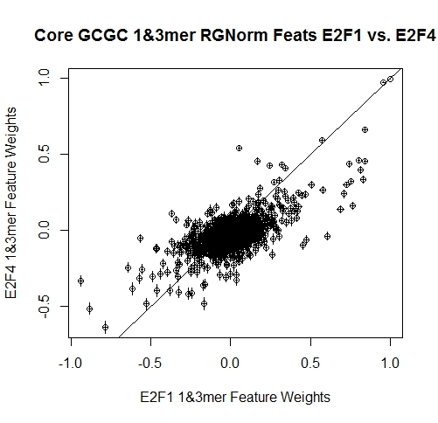
GCGC Norm

Slide 8
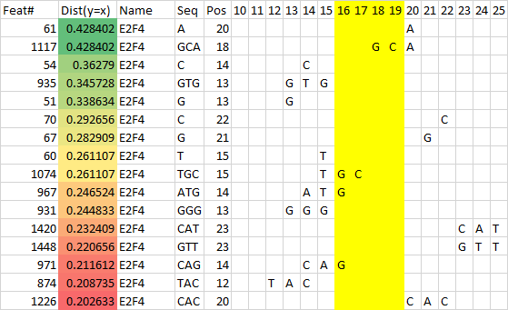
E2F4 GCGC

Slide 9
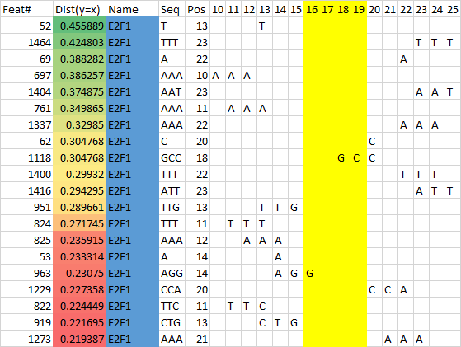
E2F1 GCGC

Slide 10
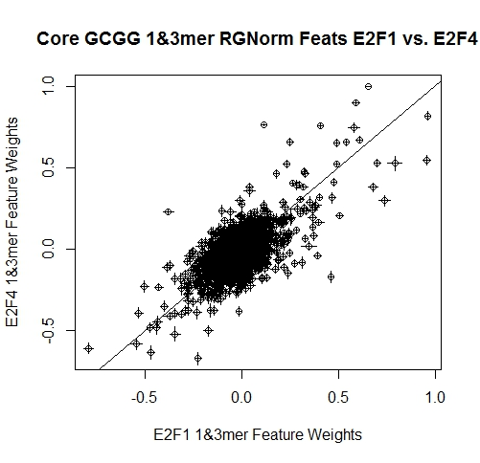
GCGG Norm

Slide 11
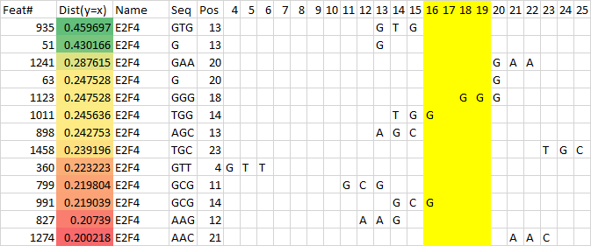
E2F4 GCGG

Slide 12
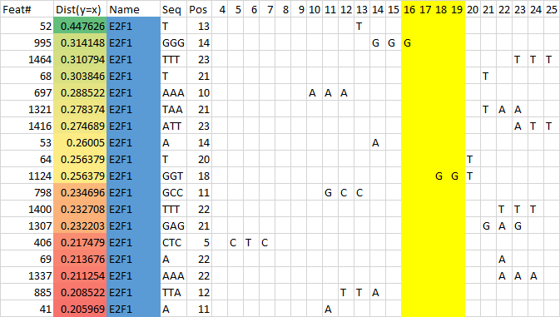
E2F1 GCGG

Slide 13
Comparison between GCGC and GCGG
Notes:
GCGG varies more from y=x line

Slide 14
Conclusions
Genomic context is important
E2F1 prefers sequences with identical 3mers
Sequences with core GCGG is less predictable

Slide 15
Bibliography
Gordân, Raluca et al. “Genomic Regions Flanking E-Box Binding Sites Influence DNA Binding Specificity of bHLH Transcription Factors through DNA Shape.” Cell reports 3.4 (2013): 1093–104. Web. 4 Mar. 2015.
http://www.bio.miami.edu/dana/pix/transcription_factor.jpg
http://www.saedsayad.com/images/SVR_1.png
http://www.mdpi.com/sensors/sensors-12-12489/article_deploy/html/images/sensors-12-12489f7-1024.png

Slide 16
Acknowledgements
Dr. Gordan, Duke University
Mr. Gotwals, NCSSM
Dr. Shoemaker, NCSSM
Summer Research Internship Program

Slide 17
Questions?

